Slide 1


Beer Data Analysis
Analyzing Beer data and creating a machine learning algorithm to help users make the decision which beer they should get based on flavor profiles.

Slide 2




The Team
<- Timothy Malasky
github.com/Tmalasky
<- Jack Moletteire
github.com/jmoletteire
<- Souleymane Ndiaye
github.com/muurid1

Slide 3
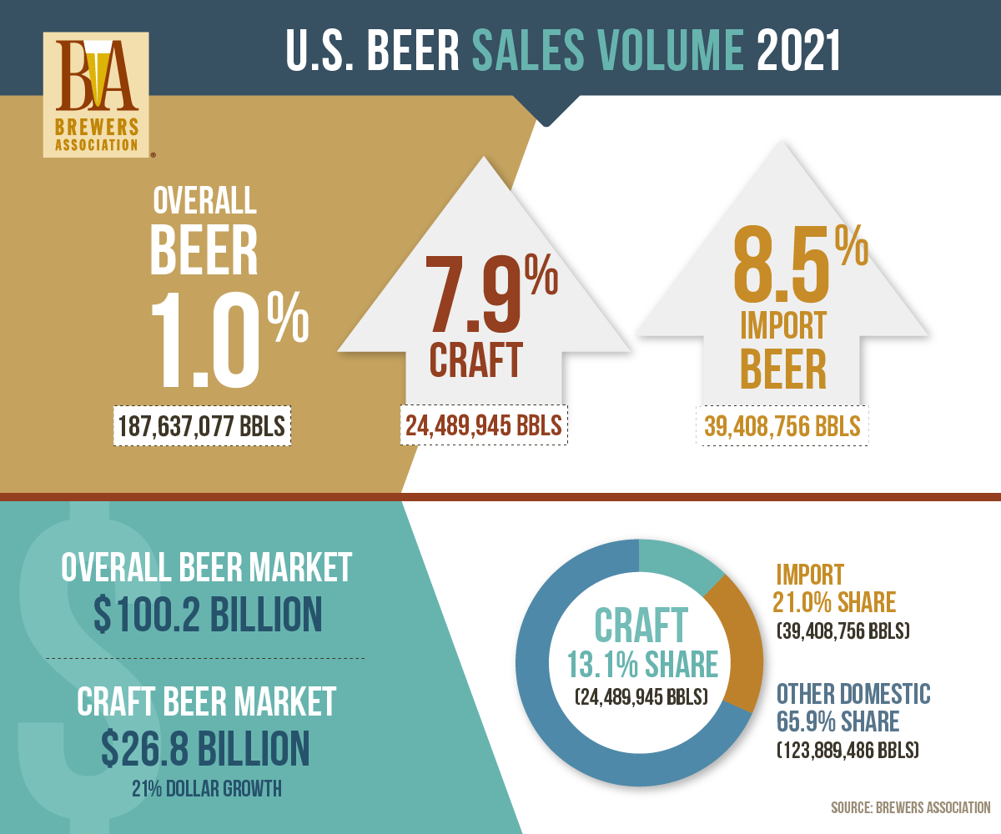
Why Beer?
Craft beer is becoming increasing demanded by consumers in today’s market.
Consumers’ willingness to spend more on craft beer based on variety, flavor and quality has increased since its beginnings in the 1960s.
Craft beer is typically made with higher quality ingredients, which provides consumers with a more flavorful and distinctive tasting beer than mass-produced options.
Those reaching for a craft beer often want something new.

Slide 4

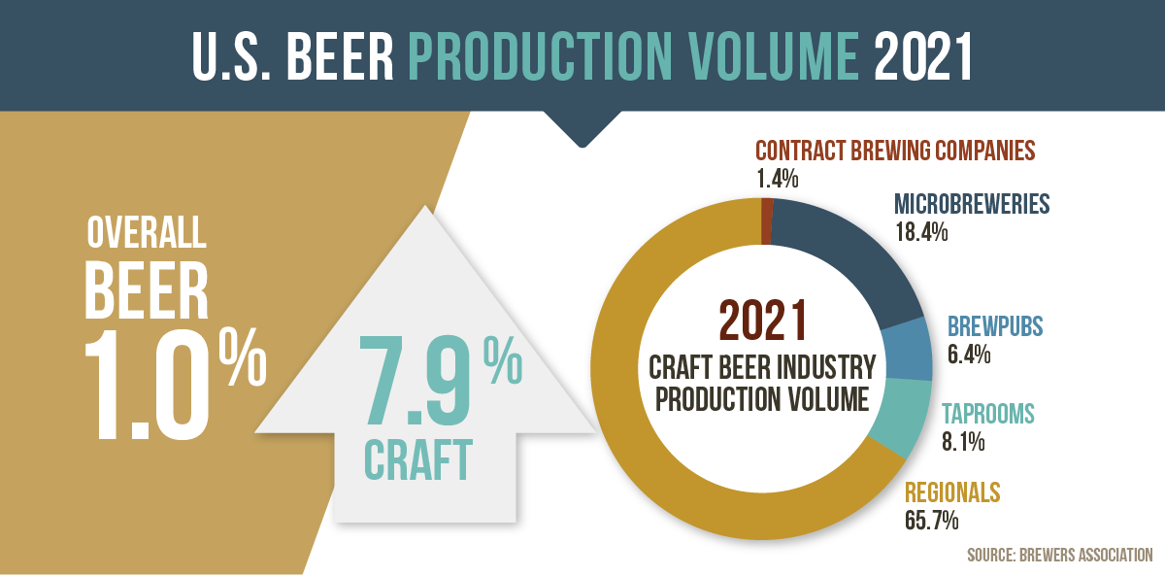
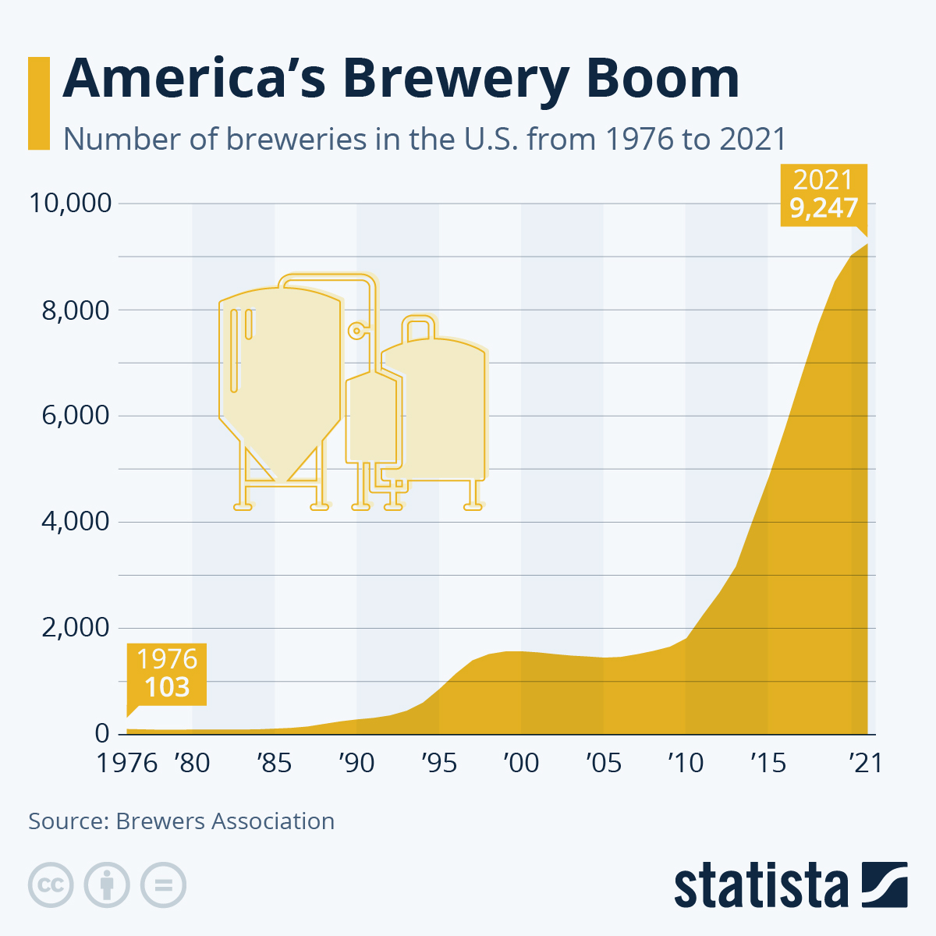
Craft Beer Trending Higher in America each year
The First graph shows U.S. Beer Production Volume in 2021 based on breweries.
The Second graph shows the numbers of breweries being open in the U.S. growing each year since 1976.

Slide 5
Database
The database we are using is from Kaggle and is a Beer Profile and Ratings Data Set.
The Database shows the name and style of beer and is broken down by different descriptions which we use in our recommender system to determine the right beer just for you!
The Database also shows different review scores based on the aroma, appearance, palate, taste, and overall scores.

Slide 6
Machine Learning
We are building a multi-class classification model that will analyze user preferences to determine preferred beer style and make recommendations.
Preliminary analysis and preprocessing involved analyzing variables (e.g., ABV, min./max. IBU, taste profile, review data, etc.) and grouping related data. A SQLite database was created to store several tables of related information such as taste data, review scores, and names & breweries, creating a more organized source.
After building the database, there was further discussion about the direction of the project, at which point we decided the model would only learn from objective*, numerical data. This meant only taste profile (e.g., Astringency, Bitterness, Saltiness, etc.) and chemical composition (ABV, min./max. IBU) would be considered in the construction of the model, while review data and identifying information would be excluded. The choice was made with the belief that a model based on factual data would provide more significant output than one that considered more opinionated statistics such as review scores, which we believed were more volatile, and susceptible to outliers.

Slide 7
Questions for our Dataset
What style of beer is most popular based on data from consumers?
Which flavor profile is most popular based on the dataset?
What type of beer you might prefer based on your input of type of taste preferences?
Which breweries have the most popular beers based on reviews?

Slide 8
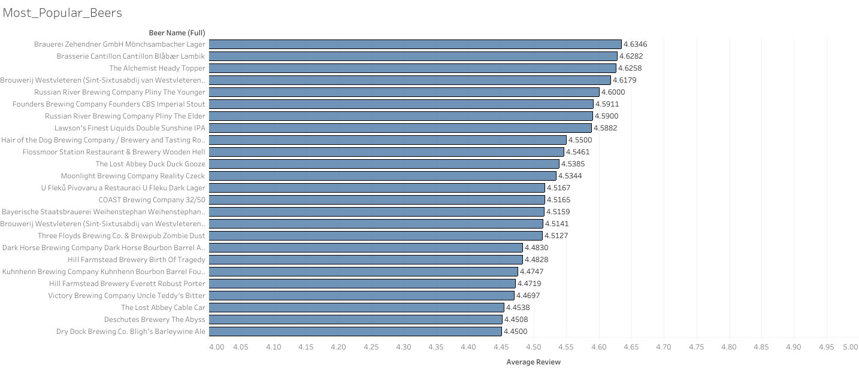
Most popular beers based on reviews from the Dataset.
Most popular beers based on overall review scores using a 4-5 scale. Showing the top 25 in this category.

Slide 9
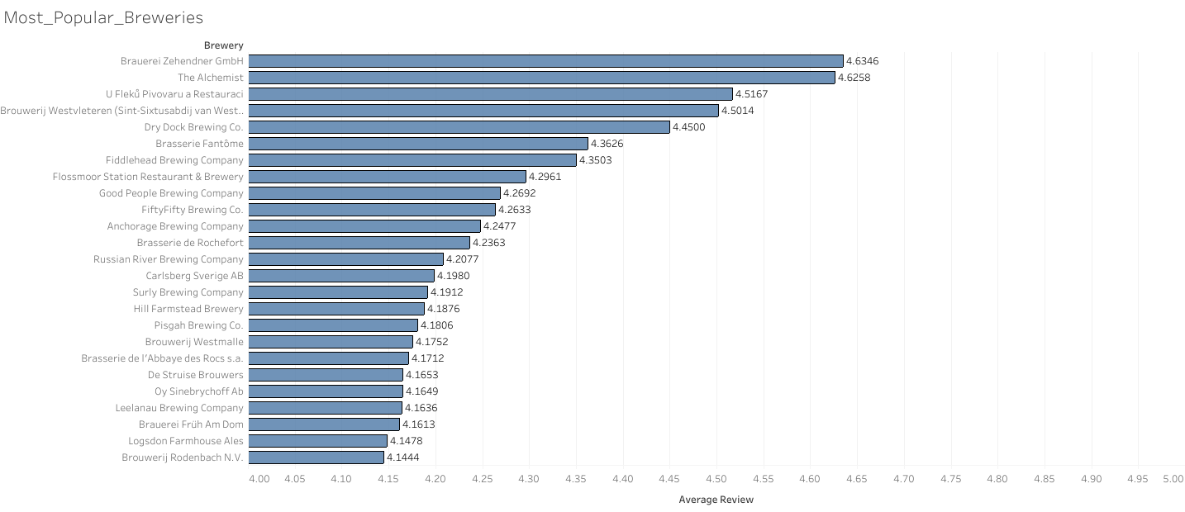
Most popular Breweries based on reviews from the dataset.
Most popular Breweries based on review scores using a 4-5 point scale. Showing the top 25 in this category.

Slide 10
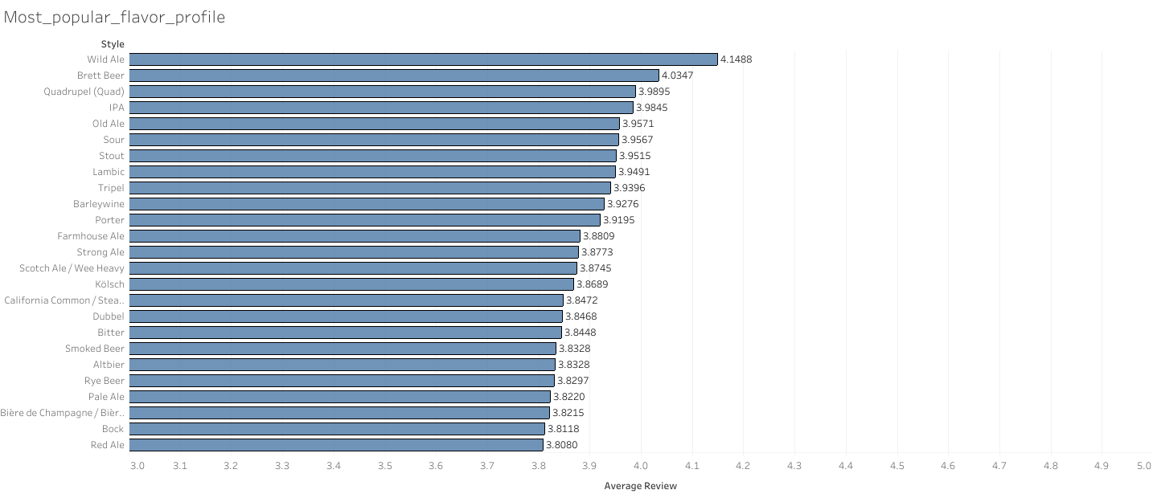
Most popular flavor profile based on reviews from dataset.
Most popular flavor profile based on review scores using a 3-5 point scale. Showing the top 25 in this category.

Slide 11
Beer Recommender Application

